Slide 1
Crowd flow segmentation normal Avrg field vs Avrg TEF field

Slide 2
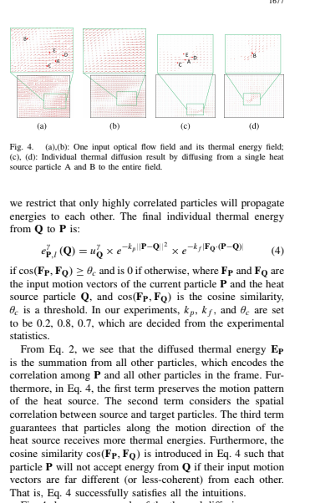
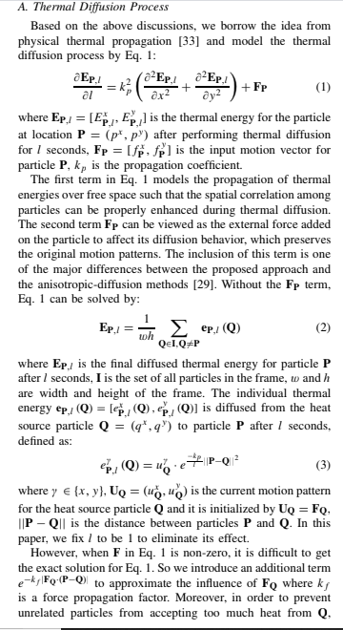
EQUATION USED TO FIND TEF FIELD

Slide 3

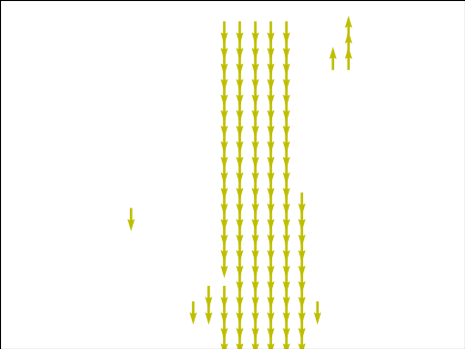
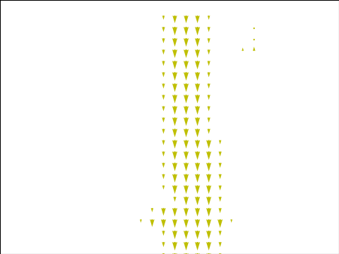
Sequence 1
Avrg vector field without tef
Avrg vector field with tef

Slide 4
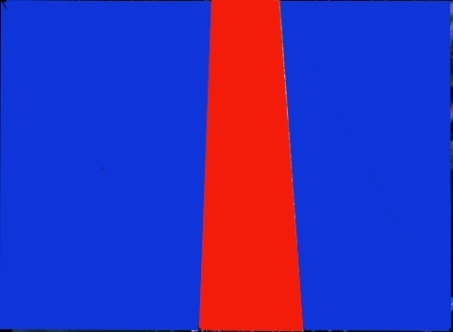


Sequence 1 without tef
Morphological
Output
Final output
No of clusters after merging:1
No of clusters before merging:1

Slide 5


Sequence 1 with tef
Morphological
Output
Final output
No of clusters after merging:1
No of clusters before merging:1

Slide 6

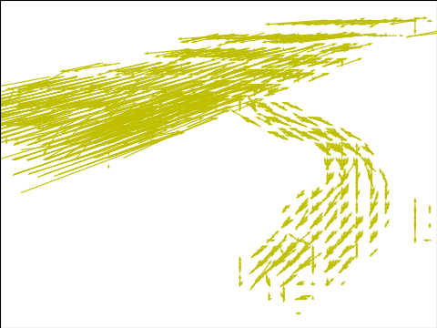
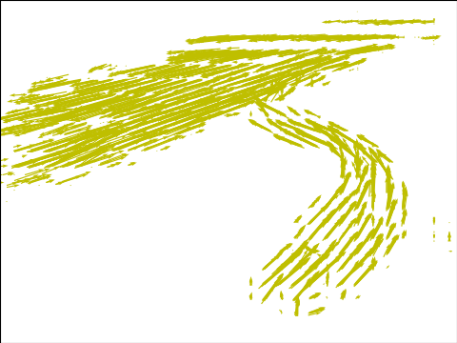
Sequence 2
Avrg vector field without tef
Avrg vector field with tef

Slide 7

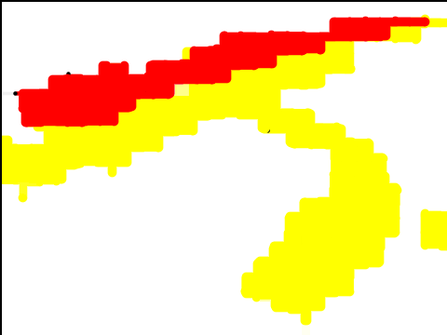
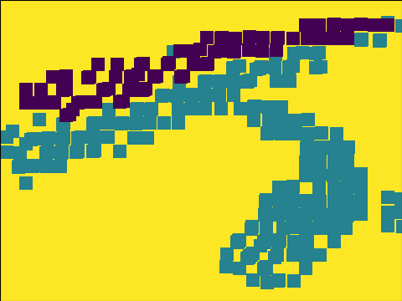
Sequence 2 without tef
Morphological
Output
Final output
No of clusters after merging:2
No of clusters before merging:16

Slide 8
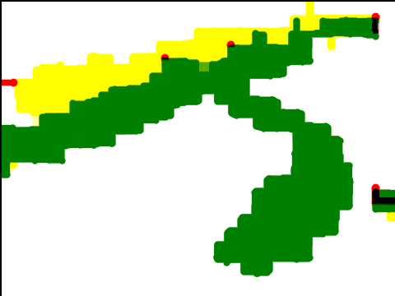
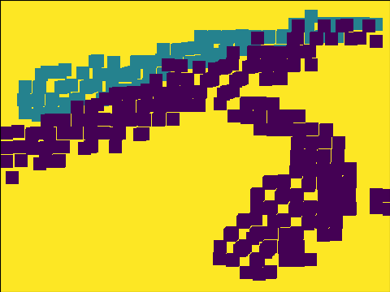
Sequence 2 with tef
Morphological
Output
Final output
No of clusters after merging:2
No of clusters before merging:6

Slide 9
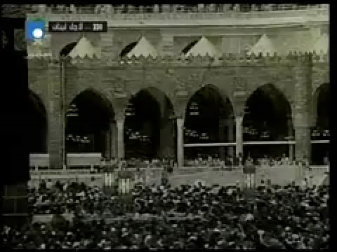
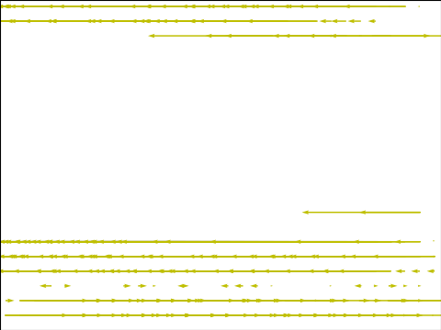
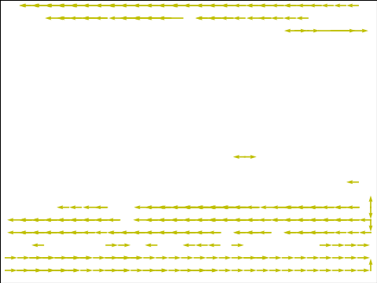
Sequence 3
Avrg vector field without tef
Avrg vector field with tef

Slide 10

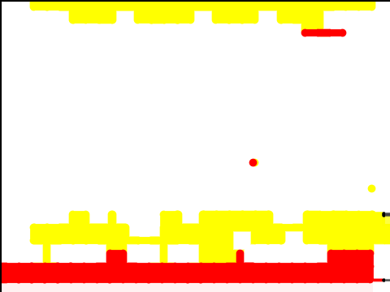
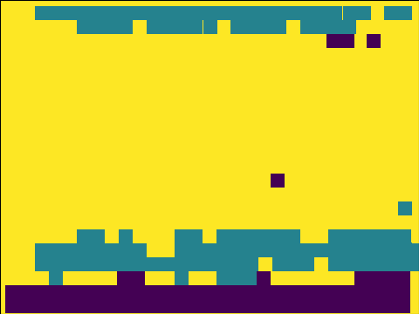
Sequence 3 without tef
Morphological
Output
Final output
No of clusters after merging:2
No of clusters before merging:2

Slide 11
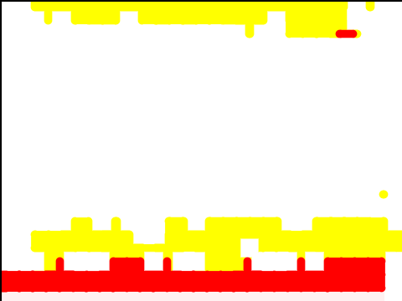
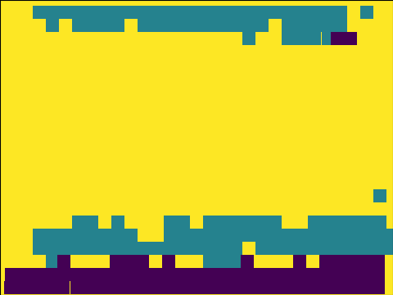
Sequence 3 with tef
Morphological
Output
Final output
No of clusters after merging:2
No of clusters before merging:2

Slide 12
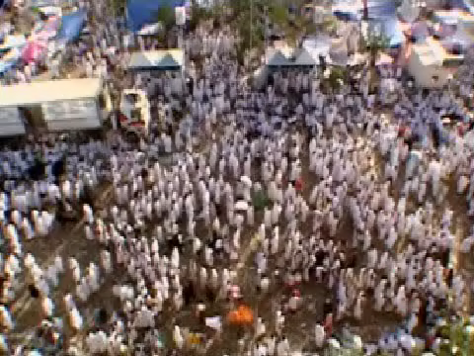
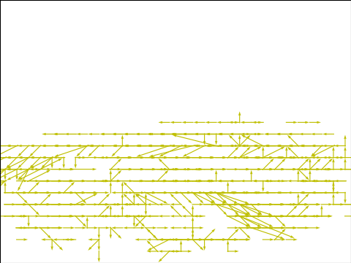
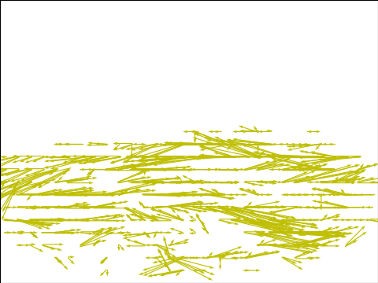
Sequence 4
Avrg vector field without tef
Avrg vector field with tef

Slide 13
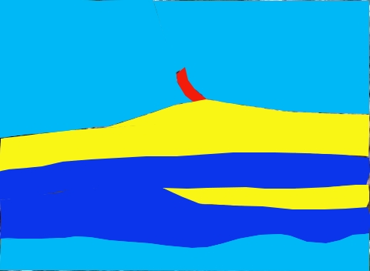
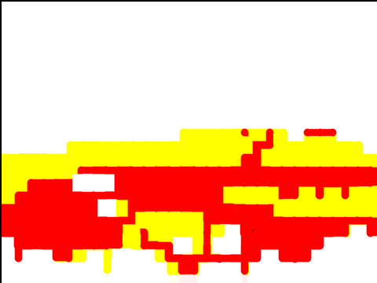

Sequence 4 without tef
Morphological
Output
Final output
No of clusters after merging:2
No of clusters before merging:9

Slide 14
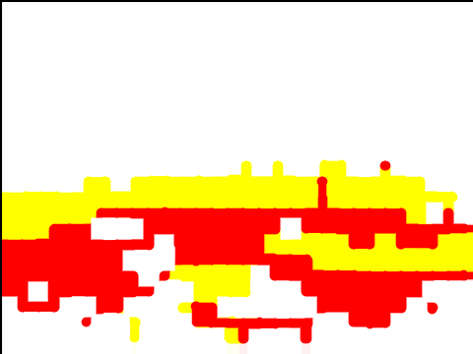

Sequence 4 with tef
Morphological
Output
Final output
No of clusters after merging:2
No of clusters before merging:2

Slide 15

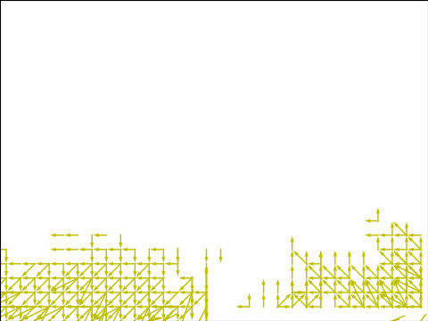

Sequence 6
Avrg vector field without tef
Avrg vector field with tef

Slide 16
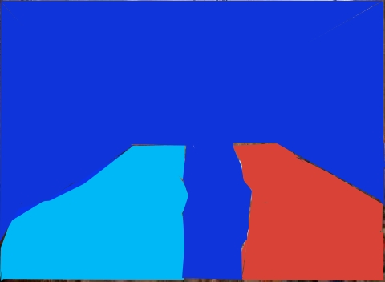
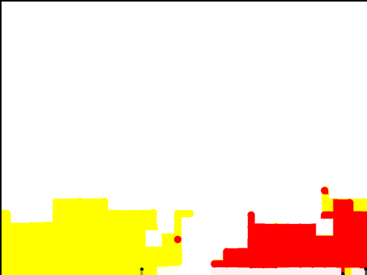

Sequence 6 without tef
Morphological
Output
Final output
No of clusters after merging:2
No of clusters before merging:7

Slide 17


Sequence 6 with tef
Morphological
Output
Final output
No of clusters after merging:2
No of clusters before merging:2

Slide 18
THE END

